Slide 1

Neonatal Assist
Jessica Chaya, Xiaoxia Jian, & Tobias Kahan, Presentation
Notes:
Toby
We are team Neonatal Assist.
Our Dev Team consists of Jessica Chaya, Xiaoxia Jian, and Tobias Kahan (me).

Slide 2

Link
Please visit us during the presentation.
neonatal-assist.herokuapp.com/
Notes:
Toby

Slide 3
PROJECT STATEMENT
PROBLEM
Nurses do not have fast access to current point-of-care support tools to assist in daily neonatal care.
SOLUTION
Create a visual and instructional mobile app that provides a collection of diagnostic and reference tools to assist nurses in neonatal care.
Notes:
Toby

Slide 4

System Architecture
Happy User
Android
iOS
Browser
Server
html
javascript
form-def.json
ODK Library
Excel
Excel
Notes:
Xiaoxia

Slide 5
PROJECT PROGRESS Completed and In Progress
Creating unique ODK prompt types and handlebars
Menu (In progress)
Image Slider (In progress)
Displaying images and video in ODK Survey.
Implementing different calculators (In progress).
Hosting on Heroku with Node.js backend.
Basic UI and navigation.
Notes:
Jessica

Slide 6

PROJECT PROGRESSGoals and Reach
Confident Goals
Finish Ballard Exam.
Medicine Dosage Calculator.
Weight Loss Calculator.
Glucose Infusion Rate Calculator.
Apgar Score.
Procedures (Intubation and Catheters).
Reach Goals
Wrap Neonatal Assist in Android and iOS apps.
Lab Tools (Electrolytes and Full Blood Count).
Diagnostics (Line Placement and Chest/Abdominal Xray).
Notes:
Jessica

Slide 7
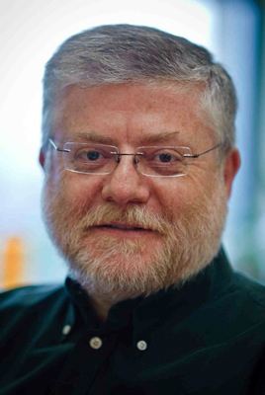

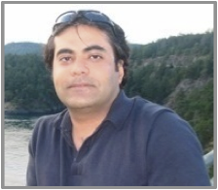
Self-Evaluation
How we will evaluate ourselves?
Functionality
Usability testing from nurses and feedback
Platform-compatibility
Notes:
Jessica

Slide 8

Questions?
?
Notes:
Development Team

